Slide 1
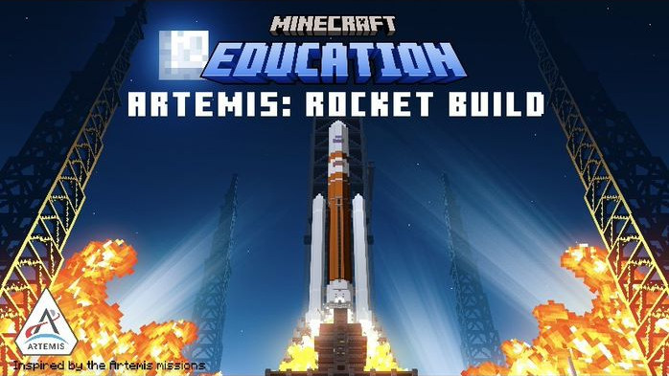

Slide 2
What will we learn today?
  I will learn about the Artemis program and its impact on past, present, and future space exploration missions.
  I will explore various rocket parts.
  I will learn about the scientific phenomena and laws that impact rockets’ ability to fly.
  I will build and test different types of rockets.
  I will redesign and paint my own rocket build to test in the simulator.

Slide 3



Important vocabulary
Force | Motion
Forces can be described as a push or pull on an object. They can be due to phenomena such as gravity, magnetism, or anything that might cause a mass to accelerate. | Motion is the action or process of moving or being moved.

Slide 4
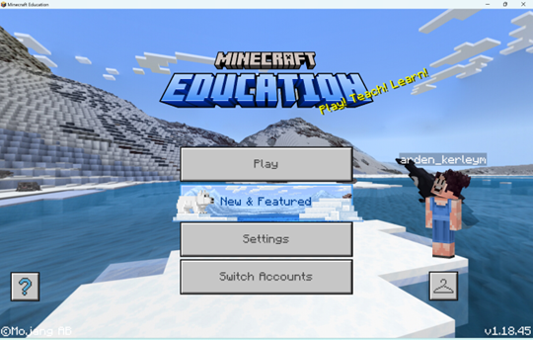
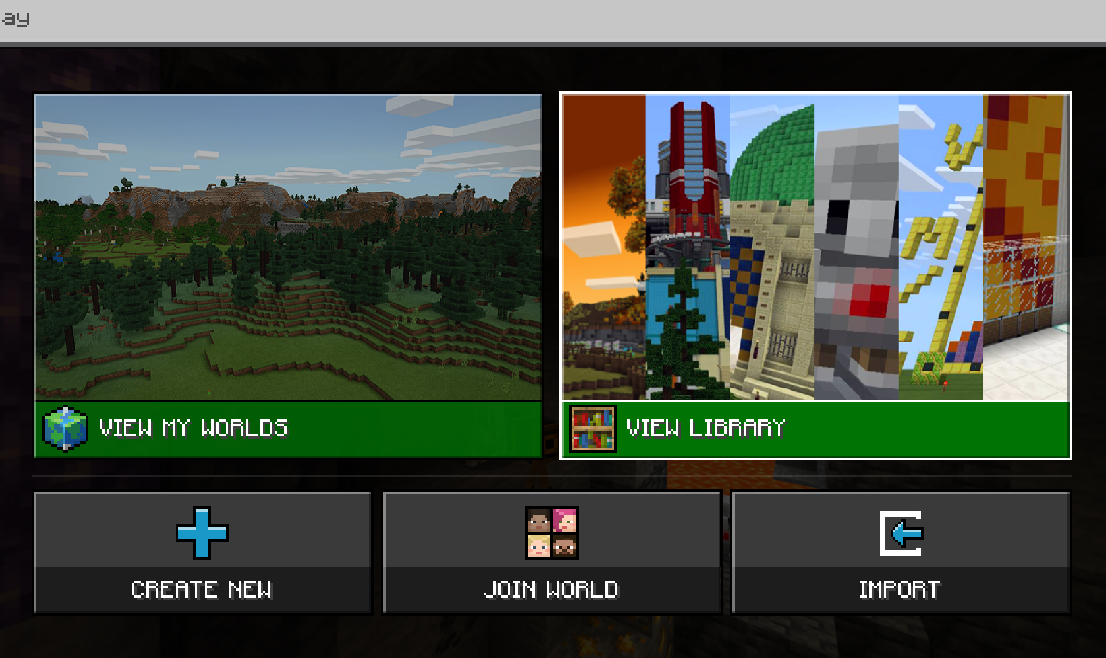


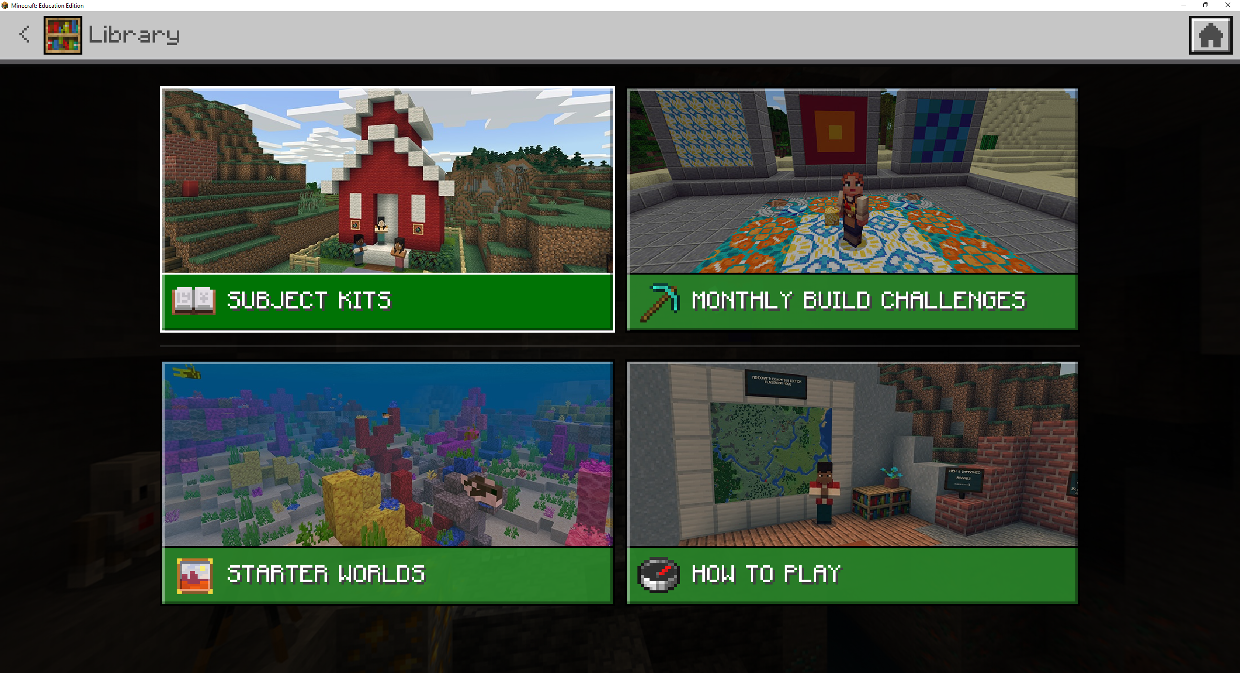
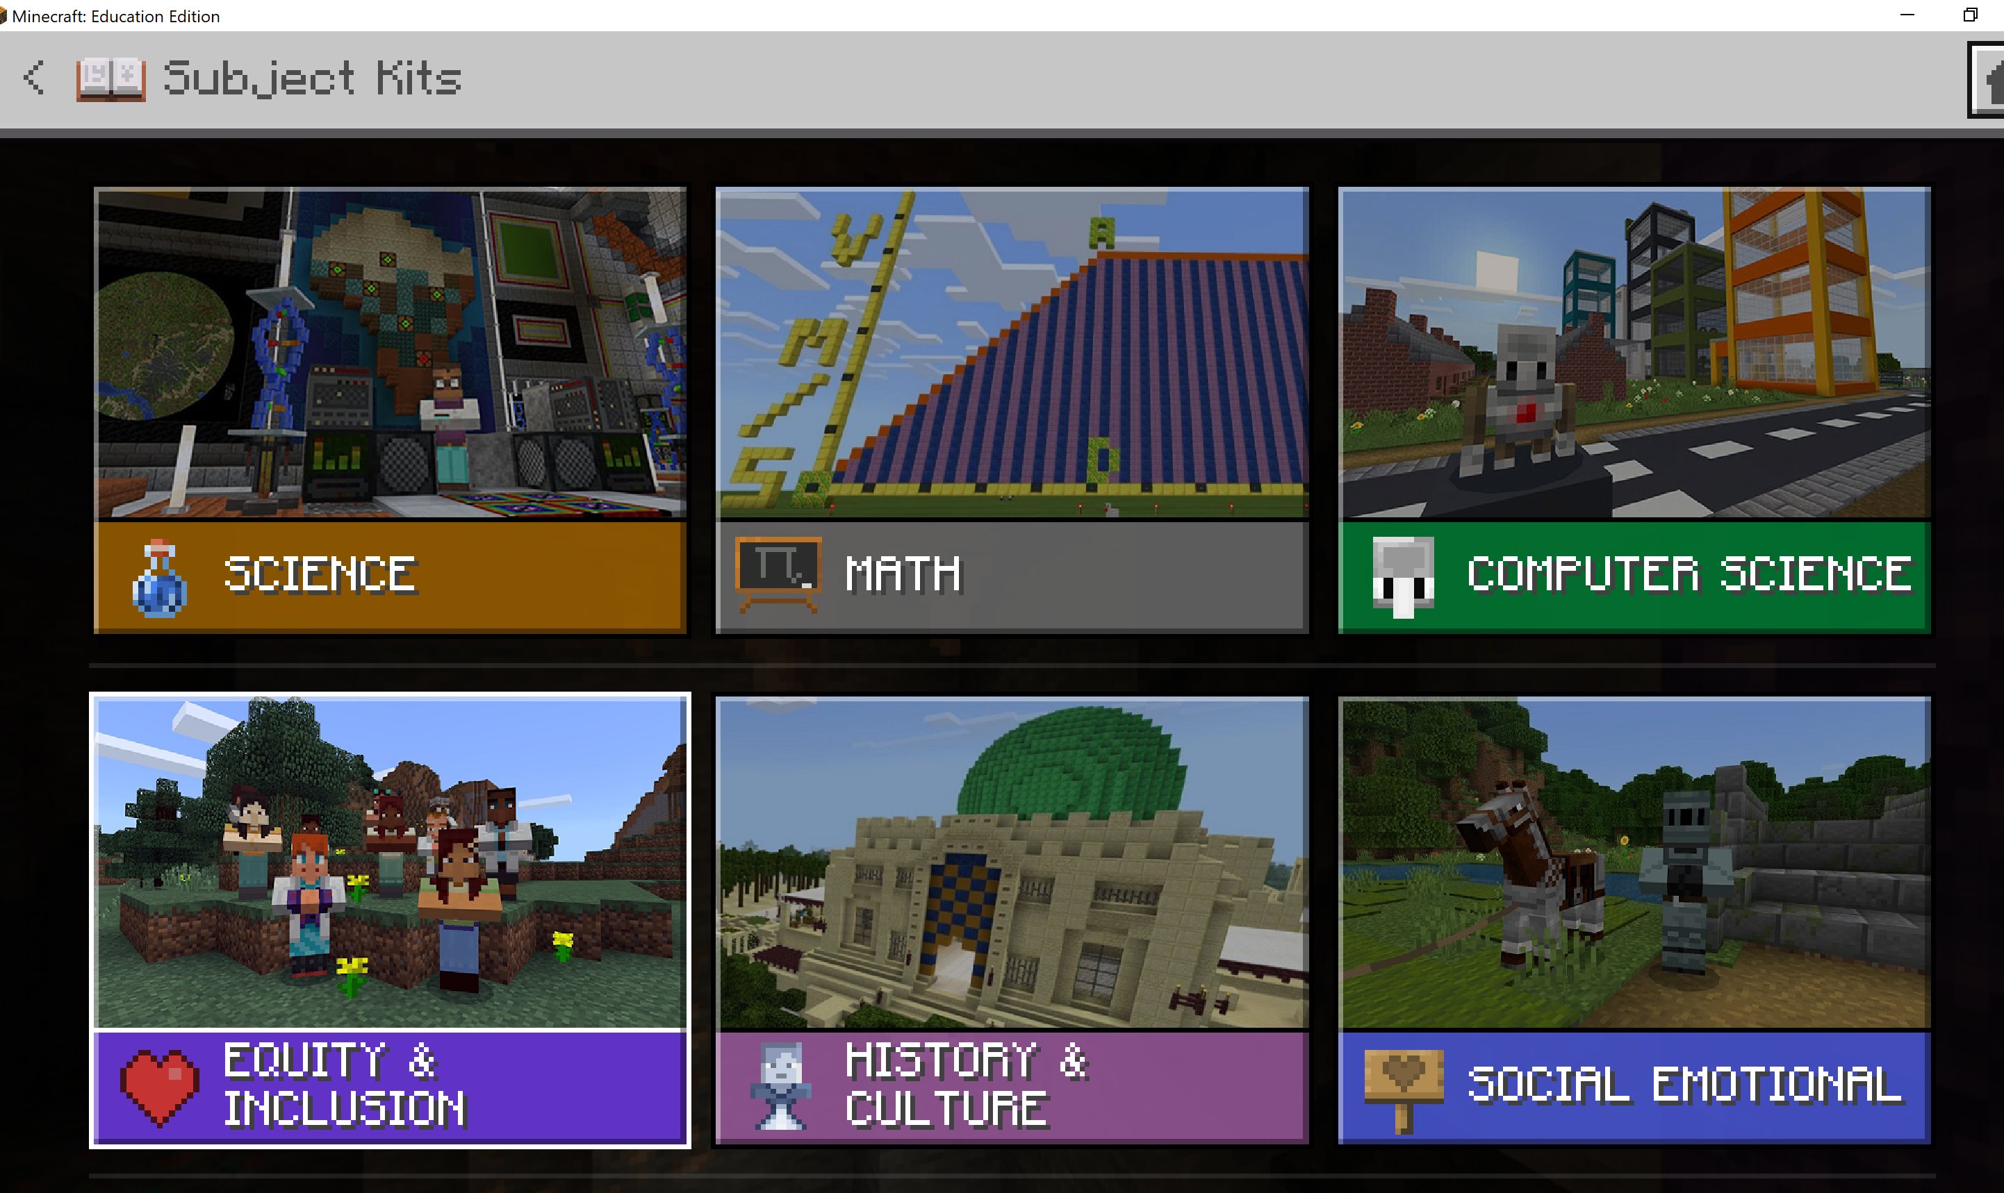

Navigating in Minecraft Education
1
2
3
4

Slide 5
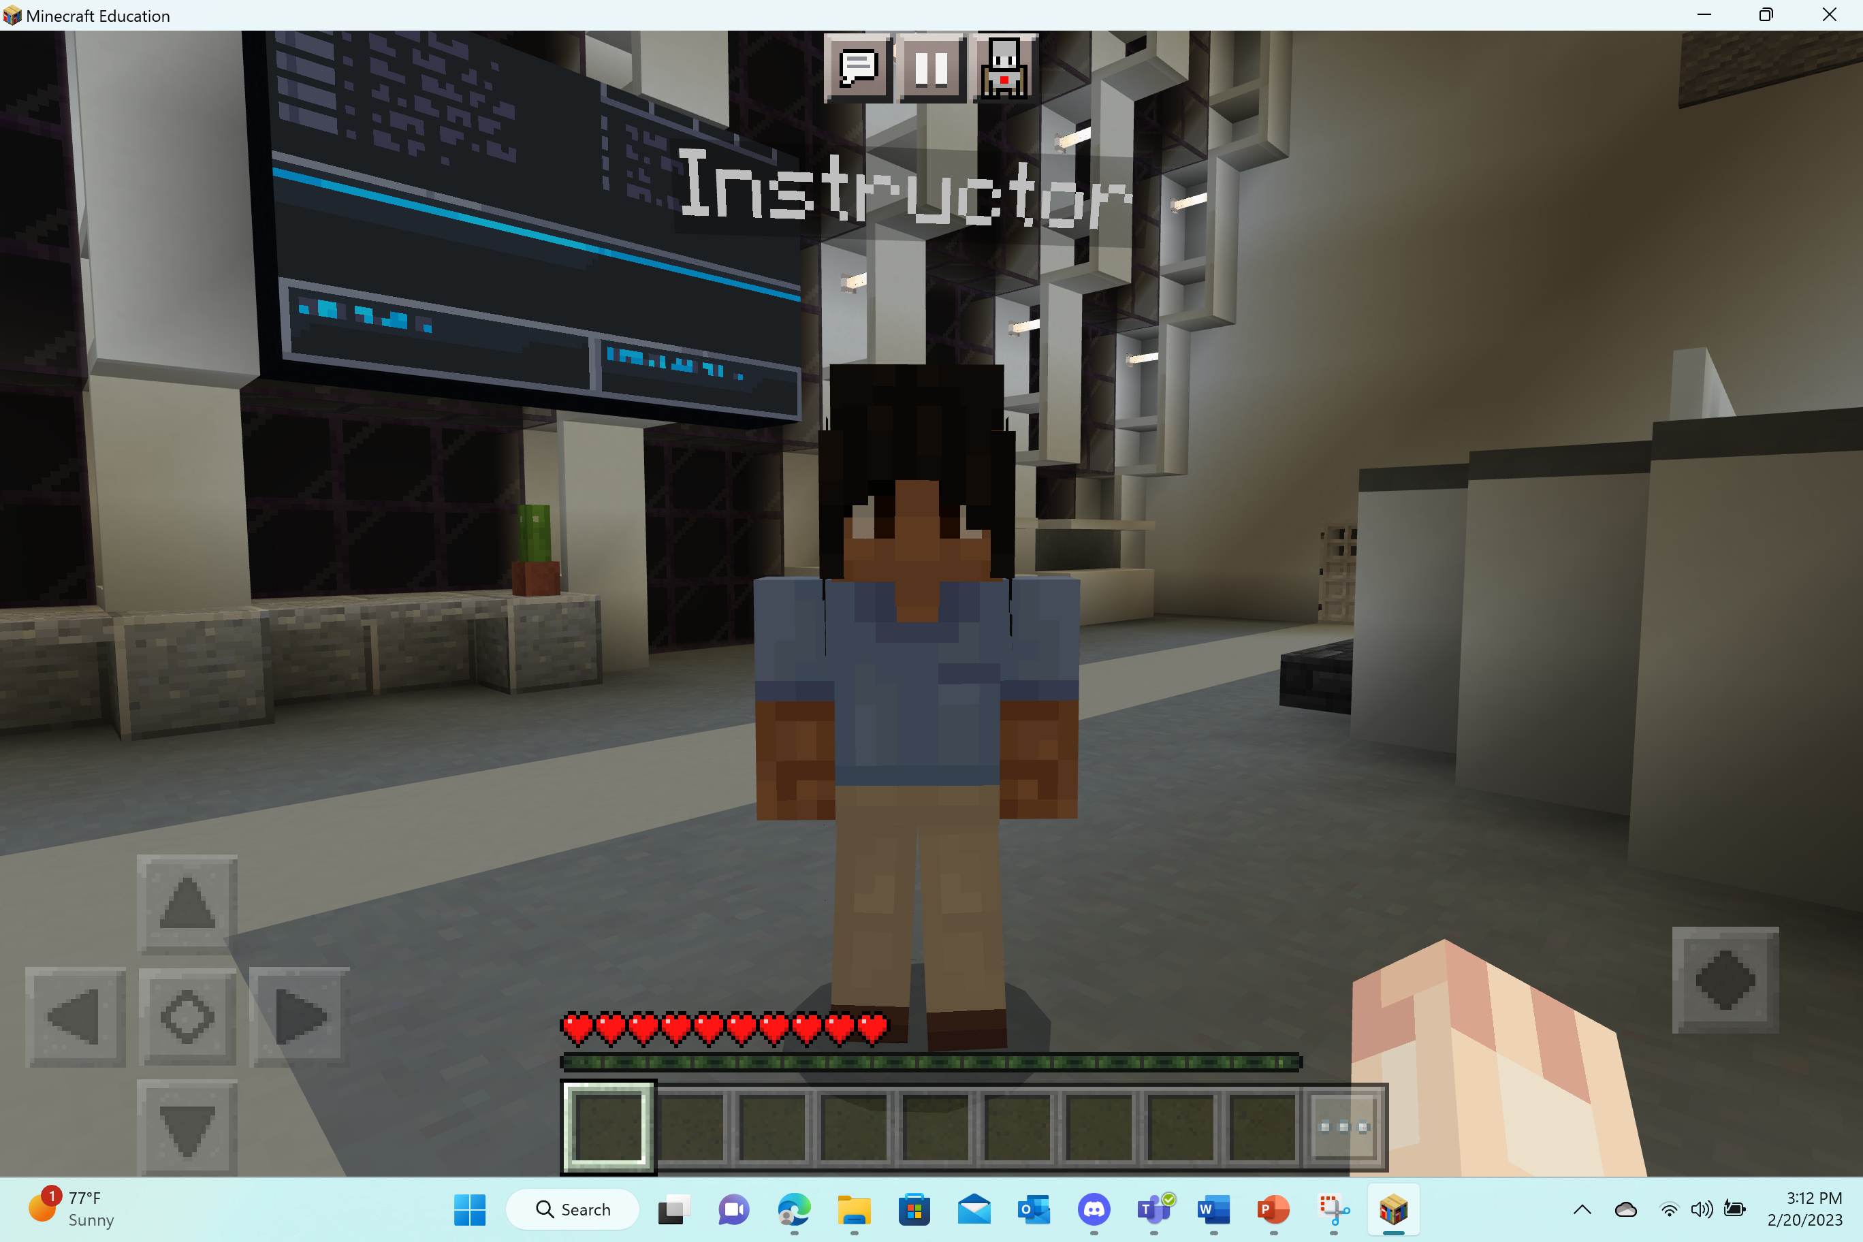
Tutorial sequence
Welcome to Artemis: Rocket Build!
This is your spawn point – the place you will begin game play.

Slide 6
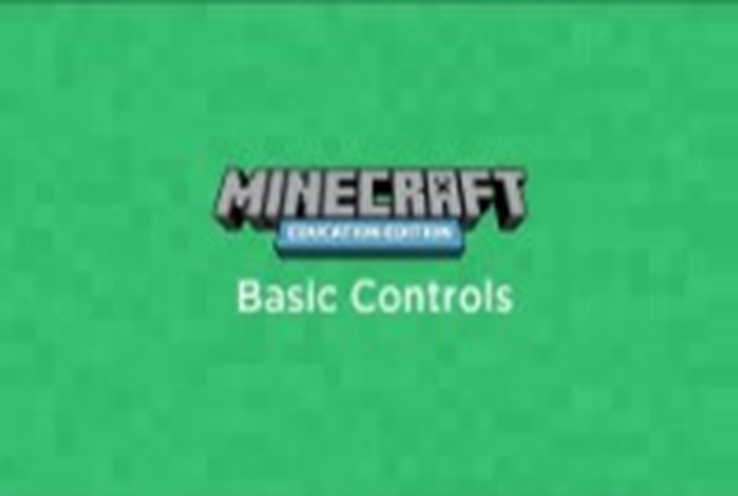
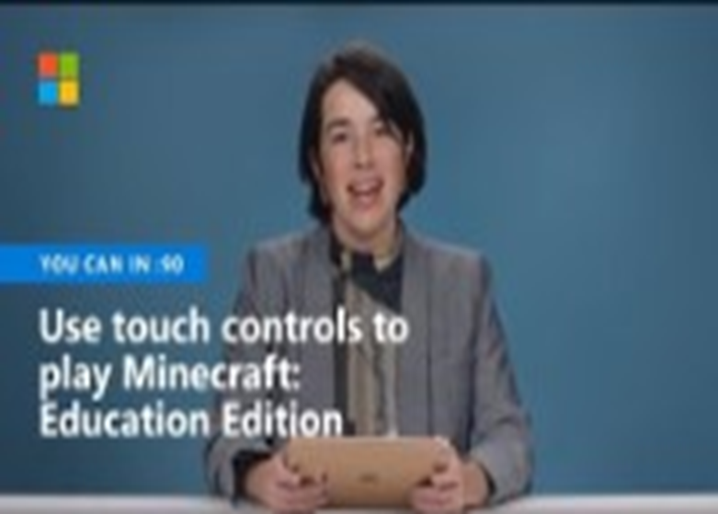
Getting started in Minecraft
Keyboard | Touch Controls

Slide 7
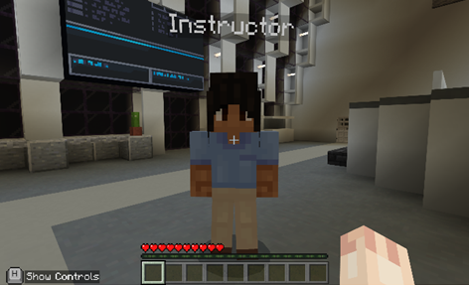
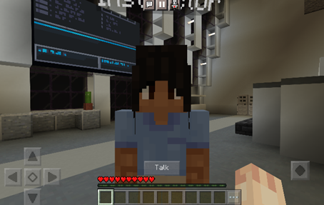
Tutorial sequence
The Instructor is an NPC (non-player character).
NPCs have important information and guidance for you. You should talk to the Instructor.
Keyboard | Touch
Move towards the NPC. Once you are within range, use the crosshairs “+” on the screen to guide them to the NPC. Then, right-click on the NPC to open the dialog box. | Move towards the NPC. Once they are within range, a “talk” button will appear above the hotbar. Tap the “talk” button to open the dialog box.

Slide 8
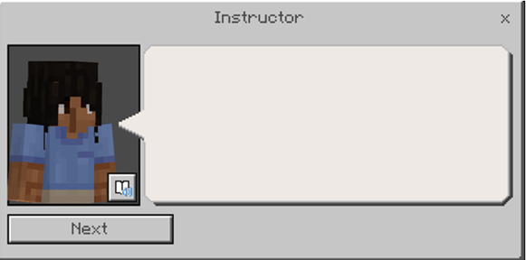
Immersive Reader
Immersive Reader can be opened inside Minecraft to read signs and NPC dialog! It is incredibly helpful! It’s great for extra help for reading, including translating the text and reading it aloud.
How to use Immersive Reader in Minecraft: Education Edition https://aka.ms/ImmersiveReaderYT

Slide 9
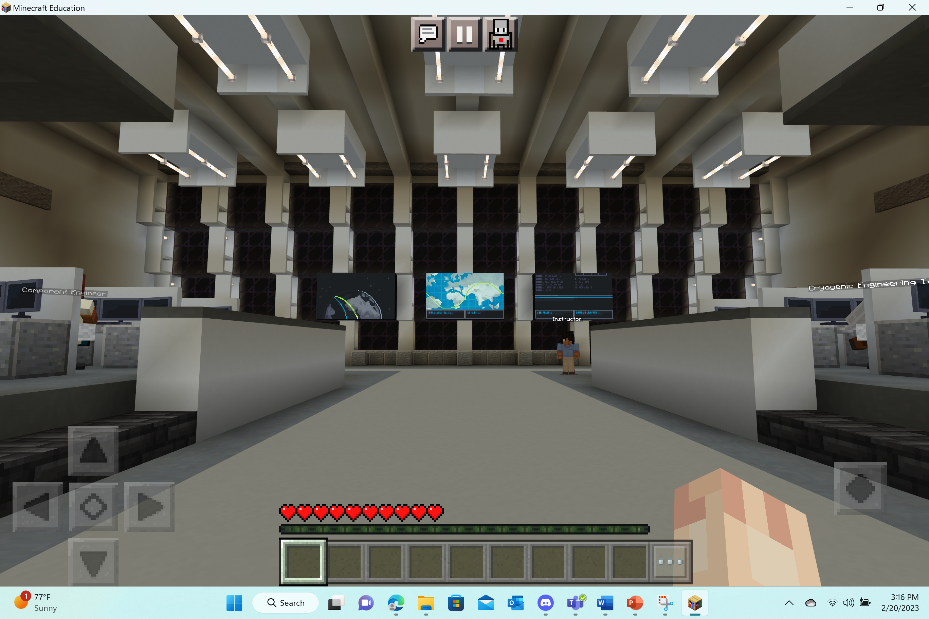
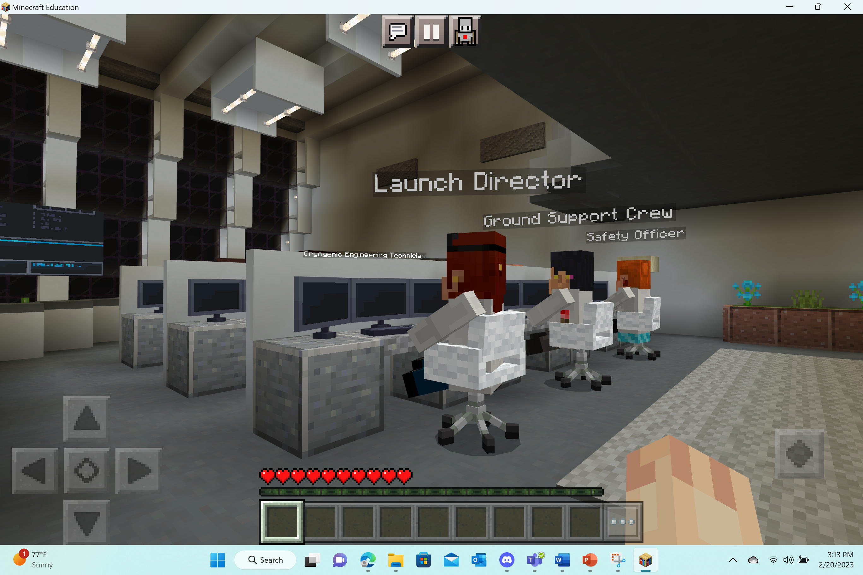
Careers at Nasa
Before going to the classrooms, interact with the other NPCs in this Launch Control room. You will learn about some cool careers at NASA – these individuals are critical for supporting the Artemis program.

Slide 10
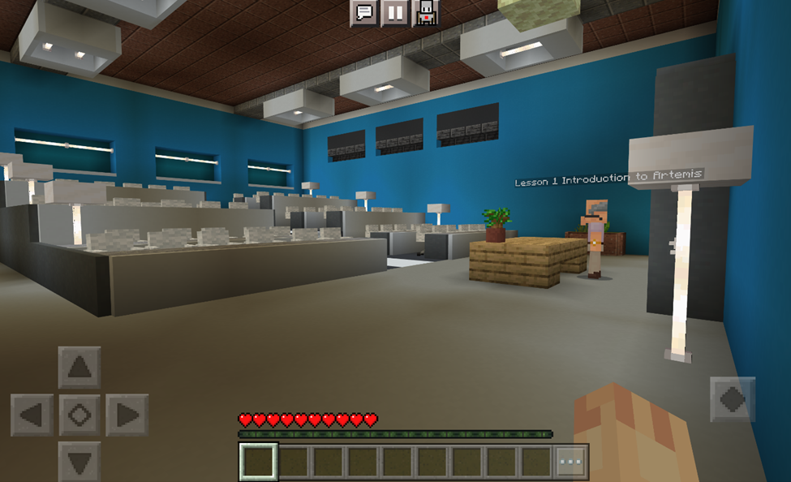
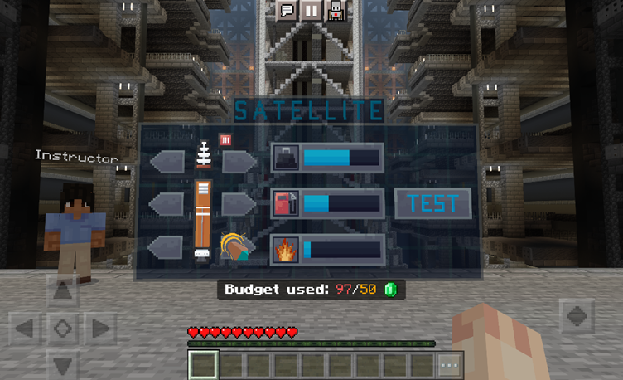
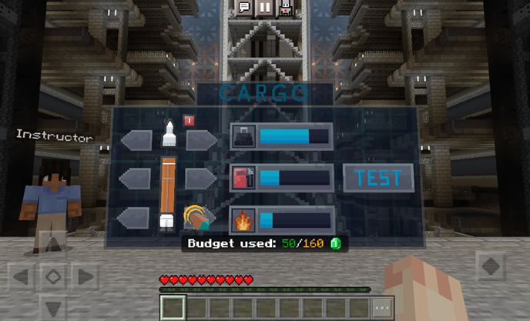
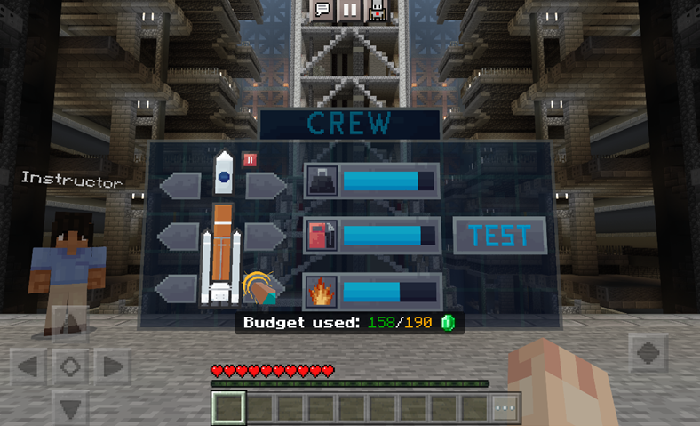
Artemis: Rocket Build Activities
Activity 1
Visit a series of classrooms to participate in four lessons about the Artemis program and the science behind the rockets!
Activity 2
In this activity, you will build, test, redesign, and paint a satellite to launch.
Activity 3
In this activity, you will build, test, redesign, and paint a cargo rocket – it will need to be able to carry the extra weight.
Activity 4
In this activity, you will build, test, redesign, and paint a spacecraft capable of carrying a crew to space!

Slide 11
Good luck and have fun!

Slide 12
Knowledge Check
What is delta-V?
a) A measure of how much a rocket's speed changes
b) A type of rocket fuel
c) The force that makes a rocket go up
d) The force of gravity on the Moon
What are Newton's laws of motion?
a) A series of laws that describe how objects move
b) A type of rocket fuel
c) The force of gravity on the Moon
d) A measure of how much a rocket's speed changes
What is the goal of our rocket project?
a) To fly to the Moon
b) To land on another planet
c) To avoid asteroids
d) All of the above
What is weight?
a) The force that makes things fall to the ground
b) The force of gravity on the Moon
c) A type of rocket fuel
d) A measure of how much a rocket's speed changes

Slide 13
Knowledge Check
What is delta-V?
a) A measure of how much a rocket's speed changes
b) A type of rocket fuel
c) The force that makes a rocket go up
d) The force of gravity on the Moon
What are Newton's laws of motion?
a) A series of laws that describe how objects move
b) A type of rocket fuel
c) The force of gravity on the Moon
d) A measure of how much a rocket's speed changes
What is the goal of our rocket project?
a) To land on another planet
b) To fly to the Moon
c) To avoid asteroids
d) All of the above
What is weight?
a) A type of rocket fuel
b) The force of gravity on the Moon
c) The force that makes things fall to the ground
d) A measure of how much a rocket's speed changes

Slide 14
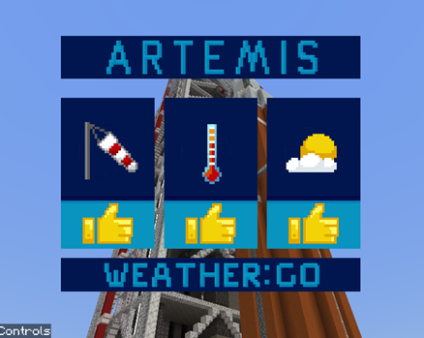
Reflection
Describe the three different Artemis missions.
What is the motivation behind the Artemis program?
How do rockets work?
Define the following terms:
  Gravity
  Weight
  Thrust
  Velocity
  Delta-V
Explain one of the careers at NASA, who supports the Artemis program.
Which one of the Artemis missions are you most excited for?

Slide 15
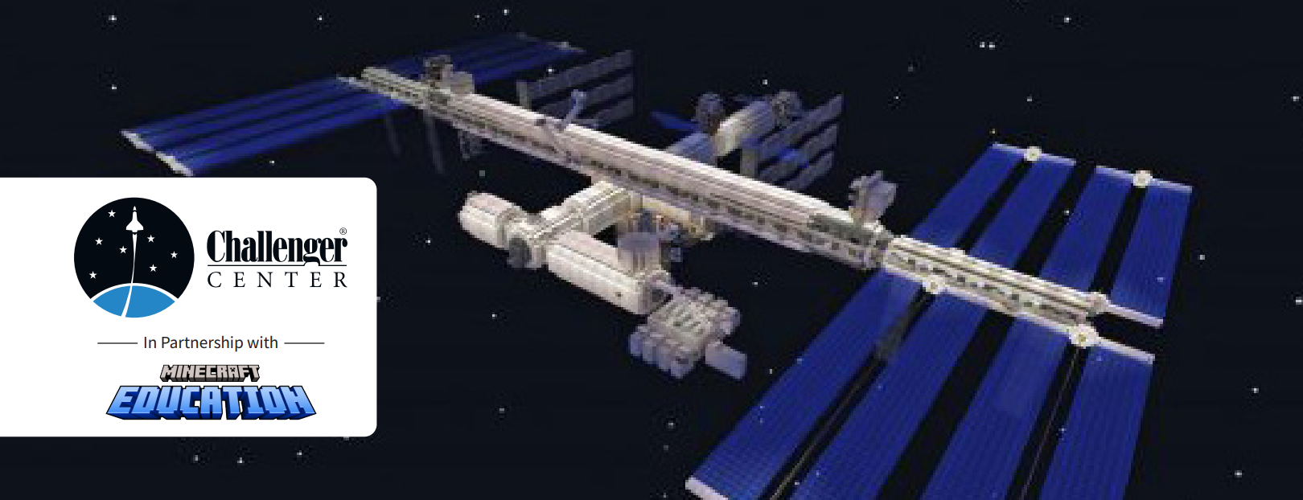
Looking for more fun?!
Challenger Center Activities
  Lesson 1: Apollo to Artemis History
  Lesson 2: NASA Coding and Diversity
  Lesson 3: Rockets
  Lesson 4: Moon Base Build
  Lesson 5: Teamwork
  Lesson 6: Luner Landing

